Slide 1
K.S.R.M COLLEGE OF ENGINEERING
RentEasy
Property & Rental Management System
A Microservice-Based Property Rental Platform
React
Spring Boot
MySQL
Full Stack Development | Academic Project

Slide 2
Team Members & Responsibilities
S.No | Name | Roll Number | Backend Task | Frontend Task
1 | N. Tulasi | 239Y1A05A7 | User Authentication & Security Service(Backend) | Project Setup and Architecture
2 | J. Mispa | 239Y1A0570 | User Authentication & Security Service(Backend) | Agent Property Dashboard
3 | Shaik Sofiya | 239Y1A04E6 | User Authentication & Security Service(Frontend) | Authentication UI Pages
4 | N. Sujini | 239Y1A05A6 | Property Listing Service | Property Listing Form (Landlord)
5 | K. Mahitha Mohan | 239Y1A0584 | Tenant Application Service | Authentication Services & State
6 | K. Swapna | 239Y1A0587 | Application Review & Approval Service | Property Search & Browse
7 | N. Srujana | 239Y1A05A5 | Lease Agreement Service | Application Submission Form
8 | R. Reddy Lakshmi | 239Y1A04D3 | Agent Property Management Service | Application Review (Landlord/Agent)
9 | Jayasree Y | 239Y1A04H3 | Landlord Controller & Dashboard Service(Frontend) | Application Status Tracker
10 | S. Sandya Urmila | 239Y1A04D9 | Landlord Controller & Dashboard Service(Backend) | Active Lease Viewer

Slide 3
Introduction
RentEasy is a full-stack web application designed to simplify property rental management between landlords, tenants, and agents.
Traditional rental systems rely on manual processes for listing properties, applying for rentals, reviewing applications, and generating lease agreements — leading to inefficiencies.
Our system digitizes the entire workflow by providing a centralized platform where all rental activities can be managed efficiently.
The application is built using React (frontend), Spring Boot (backend), and MySQL (database), following a microservices architecture.

Slide 4
Problem Statement
🔍
Tenants struggle to find reliable property listings and track application status.
📋
Landlords must manually review multiple applications — time-consuming and inefficient.
📄
Lease agreements are handled offline, making the process less transparent.
🔗
No centralized platform for landlords, tenants, and agents to interact efficiently.
Solution: RentEasy automates property listing, application management, and lease generation in a secure and structured way.

Slide 5
Proposed Solution
Core Objectives
Technology Stack
Centralized and efficient rental management platform
Landlords can list properties and manage tenant applications
Tenants can browse, apply, and track application status
Agents can monitor listings and assist landlords
Automates workflow from application to lease generation
Role-based access control with secure JWT authentication
Frontend
ReactJS
Backend
Spring Boot
Database
MySQL
Security
JWT Auth
User → React → REST APIs → Spring Boot → MySQL

Slide 6
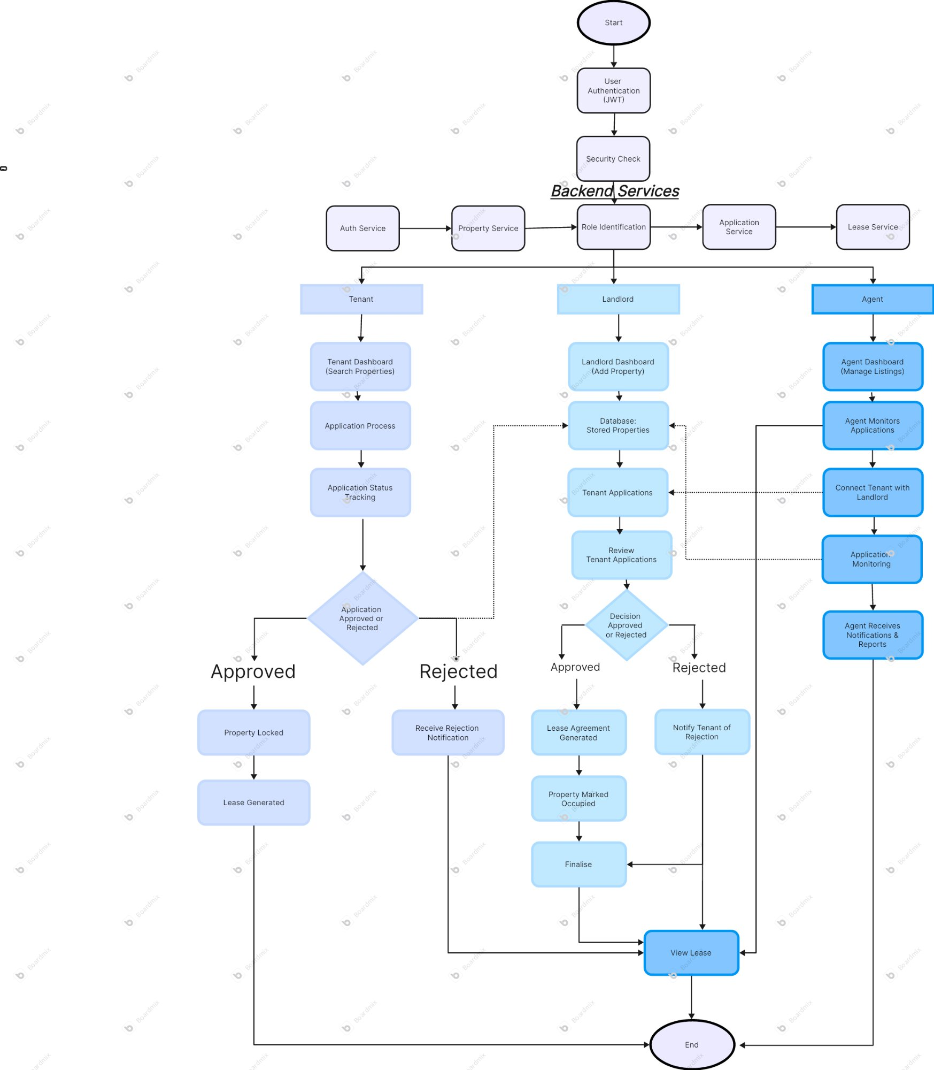
Microservices Architecture
Benefits
⚡
Scalability
Each service scales independently
🔧
Maintainability
Easier to maintain & debug
🧩
Modularity
Loosely coupled components
🚀
Independent Dev
Teams work in parallel
🔒
Fault Isolation
Failures don't cascade

Slide 7
User Authentication & Security Service — Overview
Controller Layer
Handles API Requests
API Endpoints
POST
/api/user/register
Service Layer
Business Logic
Register a new user in the system.
Accepts: username, email, password, role
Repository Layer
Database Communication
DTO: RegisterRequest { username, email, password, role }
Model Layer
Database Entities
POST
/api/user/login
Authenticate user and return JWT token.
Accepts: email, password
Security Layer
JWT Authentication & Config
Technology: Spring Security + JWT Authentication + BCrypt
DTO Layer
Data Transfer Objects
DTO: LoginRequest { email, password }

Slide 8
User Authentication & Security Service — Implementation
AuthService (Business Logic)
UserRepository (Data Layer)
Registers new users
Validates login credentials
Encrypts passwords using BCrypt
Generates JWT tokens for auth
Interacts with MySQL via JPA
Saves new user records
Finds users by email
Retrieves user details for auth
JWT Security Components
Configuration (application.properties)
JwtUtil – Generates & validates tokens
JwtFilter – Intercepts & verifies requests
SecurityConfig – Spring Security setup
Ensures stateless, secure authentication
Database connection settings
Server port configuration
JWT secret key
Other application settings

Slide 9
Property Listing Service
Overview & Technologies
Listing Form Fields
Problem:
Finding rental properties is time-consuming and inefficient in current systems.
Solution:
RentEasy provides a simple and user-friendly property listing interface.
Technologies:
React Js, React Router, React Hook Form
Structure:
components/ – Image Uploader, Address Autocomplete
pages/ – Add Property, Landlord Dashboard
Title
Property listing title
Description
Detailed property description
Property Type
Apartment, House, etc.
Rent & Deposit
Monthly rent + security deposit
Amenities
Parking, Gym, Pool, Balcony
Images
Upload property photos

Slide 10
Tenant Application Service
TenantApplicationController — Base URL: /api/tenant
POST
/api/tenant/apply
Apply for a property listing
GET
/api/tenant/application/{id}
Get a specific application by ID
GET
/api/tenant/applications/{tenantId}
Get all applications for a tenant
GET
/api/tenant/property/{propertyId}/applications
Get all applications for a property
PUT
/api/tenant/application/{id}/status
Update application status

Slide 11
Application Review & Approval Service
Tenant Submits Application
Landlord Views Applications
Landlord Approves / Rejects
Approved → Create Lease
Controller — ApplicationReviewController
Service — ApplicationReviewService
Configuration
GET
/api/landlord/applications
getApplicationsByProperty() – Fetch for a property
approveApplication() – Set status to Approved
rejectApplication() – Set status to Rejected
getApplicationById() – Return application details
application.properties: DB settings
Service configuration and ports
Spring Data JPA integration
Cross-service communication config
Get applications by property (propertyId)
PUT
/api/landlord/application/{id}
Approve or reject an application
GET
/api/landlord/application/{id}
Get a single application by ID

Slide 12
Lease Agreement Service
POST
/api/landlord/lease
Create Lease
Landlord creates a lease for an approved application. Accepts Application ID + Lease details in request body.
GET
/api/landlord/lease/{applicationId}
Get Lease by Application
Retrieves the lease associated with a specific application. Used to fetch and read lease data.
GET
/api/tenant/lease
Get Tenant Leases
Allows a tenant to view all their lease agreements by providing their tenant ID.

Slide 13
Agent Property Management Service
AgentController — Base URL: /api/agent | Role Guard: @PreAuthorize("hasRole('AGENT')")
GET
/api/agent/properties
Get All Properties
Retrieves all property listings from the database via propertyService.getAllProperties(). Allows agents to view all available properties.
PUT
/api/agent/property/{propertyId}
Update Property
Receives updated property details in request body and updates via propertyService.updatePropertyListing(). Allows agents to modify price, description, or availability.
✅ This controller allows agents to view all properties and update listings — accessible only to AGENT role users.

Slide 14
Landlord Dashboard Service — Frontend
📊
Property Cash Flow
🥧
Occupancy Pie Chart
Line chart displaying monthly income from properties. Each point represents rent income for a month.
Shows % of Occupied (green) vs Vacant (red) properties. Helps landlords understand portfolio utilization.
📋
Property Listings
👥
Tenant Applications
View all property details: Location, Rent, and Status. Button-triggered navigation to listing details.
Review incoming tenant applications. Landlord can Approve or Reject applications directly.
Technologies: HTML | CSS | JavaScript | Chart Libraries | GET & POST APIs for backend communication

Slide 15
Landlord Dashboard Service — Backend
LandlordController
Dashboard Response
Provides dashboard data for the landlord.
Annotations:
@RestController – Returns data as JSON
@Autowired LeaseService – Lease information
@Autowired PropertyService – Property info
API Endpoint:
GET /Dashboard/getDashboard
Process:
1. getTotalProperties() from PropertyService
2. getTotalLeases() from LeaseService
3. getTotalRevenue() from LeaseService
🏠
Total Properties
Returned in LandlordDashboardDTO
📄
Total Leases
Returned in LandlordDashboardDTO
💰
Total Revenue
Returned in LandlordDashboardDTO

Slide 16
Future Implementations
💳
📍
🔔
Online Payment
Live Locations
Real-Time Alerts
Integrated digital payment gateway for rent collection and deposit management.
Real-time location tracking for properties on an interactive map interface.
Push notifications for application updates, lease renewals, and payment reminders.
🤖
💬
Smart AI Recommendations
Direct Chat
AI-powered property suggestions based on tenant preferences and behavior.
In-platform messaging between landlords, tenants, and agents in real time.

Slide 17
Conclusion
🏠
Digitizes Property Listings
📋
Streamlines Tenant Applications
Streamlined online listing process for landlords and agents.
Tenants can apply, track, and manage applications digitally.
✅
Automates Approval Workflows
📄
Generates Digital Lease Agreements
Landlords review and approve applications with one click.
Automated lease creation upon application approval.
RentEasy provides a scalable, efficient, and role-based rental management system for landlords, tenants, and agents.

Slide 18
Thank You!
RentEasy — Property & Rental Management System
K.S.R.M College of Engineering | Full Stack Development
React · Spring Boot · MySQL · Microservices Architecture

